Slide 1
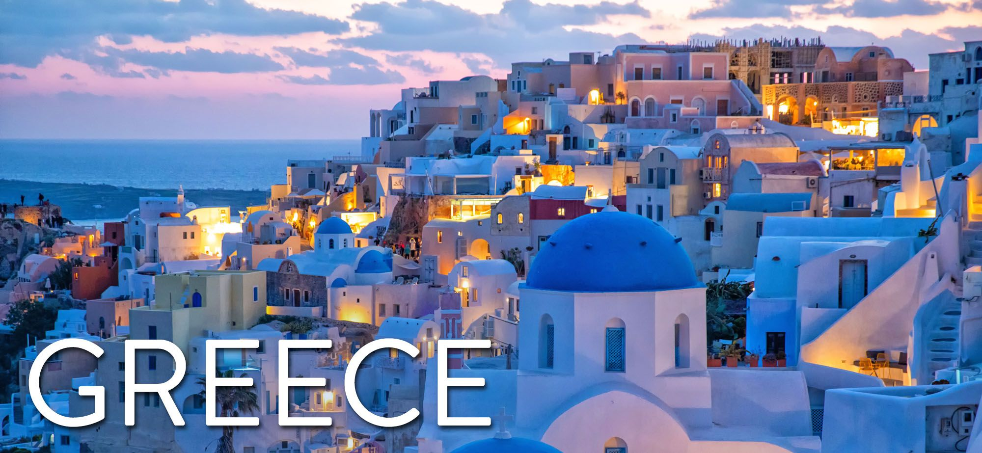
1st General Lyceum of Aigio, Greece

Slide 2
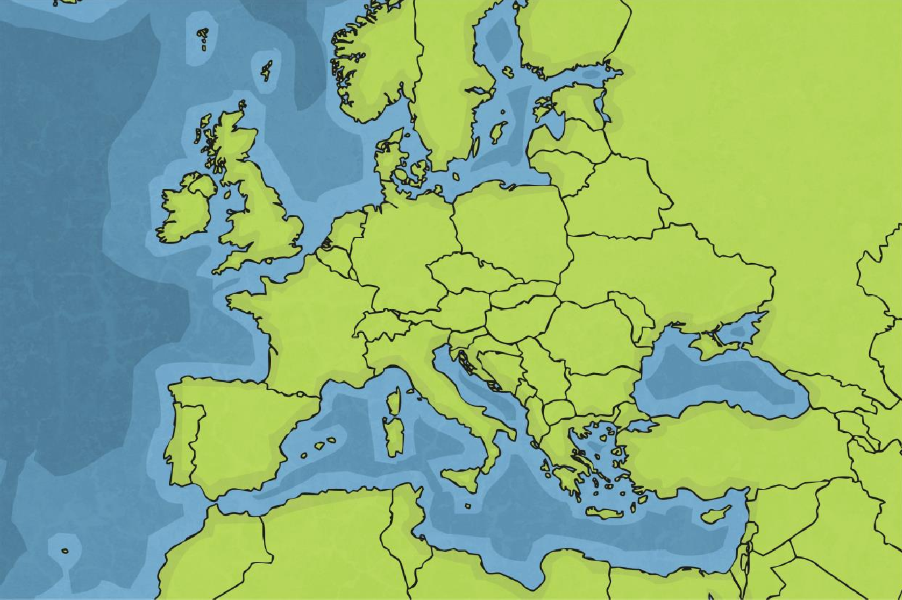
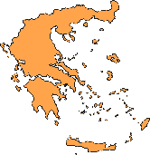
Where in the World Is Greece?
Greece is a southern country in Europe. It shares borders with Albania, Turkey, North Macedonia and Bulgaria.

Slide 3
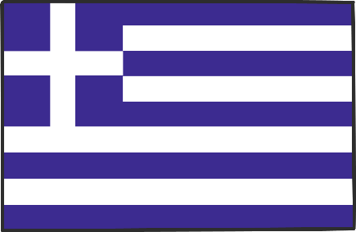
Greece: The Facts
Name: | Greece
Capital city: | Athens
Currency: | Euro (€)
Population: | 11 million
Language: | Greek
Average rainfall: | 50 – 121cm in the north 38 – 81cm in the south
Flag of Greece (Hellenic Republic)

Slide 4
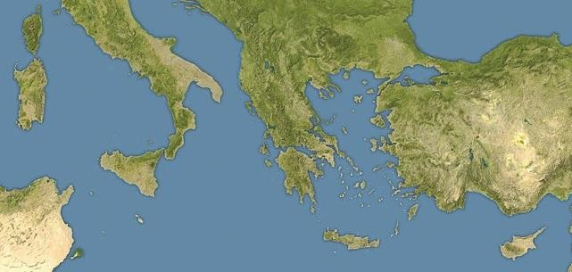
Coastline
Greece has 8479 miles of coastline.
Aegean Sea
Ionian Sea
Mediterranean Sea

Slide 5
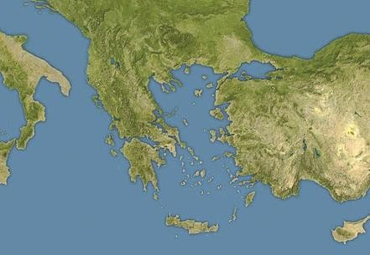
Islands
There are over 2000 islands that make up the Greek nation. Around 170 of these islands are populated. If you counted every rocky outcrop, however, the number of islands would total more than 3000. Islands account for around 20% of the country’s land area.
Crete is the largest of
the Greek islands.
Crete

Slide 6
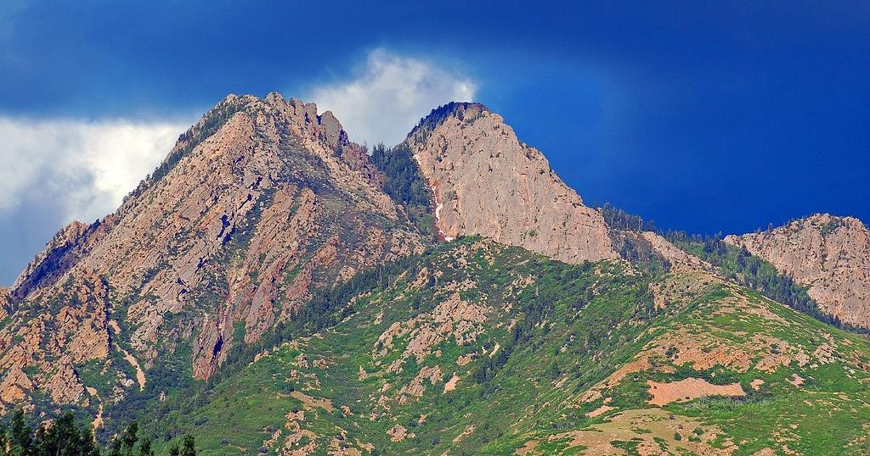
Mainland Greece
Greece is one of the most mountainous countries in Europe. In fact, there are no navigable rivers because it is so mountainous.
In Greek mythology, Mount Olympus is said to be the seat of the Gods.
Mount Olympus is the highest mountain in Greece. It measures almost 3 kms.
Photo courtesy Brett Neilson (@flickr.com) - granted under creative commons licence - attribution
According to Greek legend, when God created the world, He sifted the earth through a strainer. After giving each country good soil, he threw the stones that were left over his shoulder and created Greece.

Slide 7
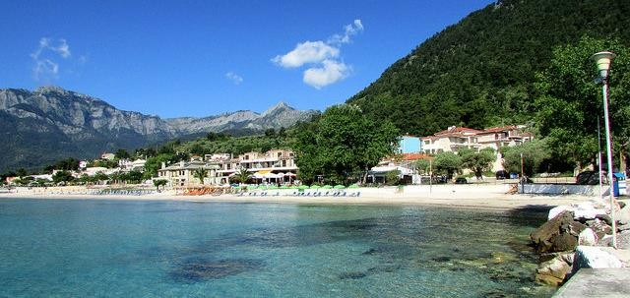
Mainland Greece
Greece has a warm, sunny climate and enjoys more than 250 days of sunshine a year. It has a typically Mediterranean climate with hot, dry summers and mild, rainy winters. Most people consider Greece to be a summer holiday destination, although there are also popular ski resorts in the mountainous
regions to the north of Athens.
Photo courtesy Ronald Saunders (@flickr.com) - granted under creative commons licence - attribution
Average summer temperature: | 33°C | Average winter temperature: | 10°C
Average summer rainfall: | 6mm | Average winter rainfall: | 65mm

Slide 8
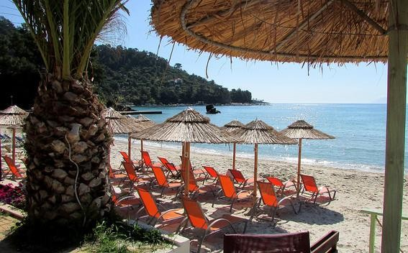
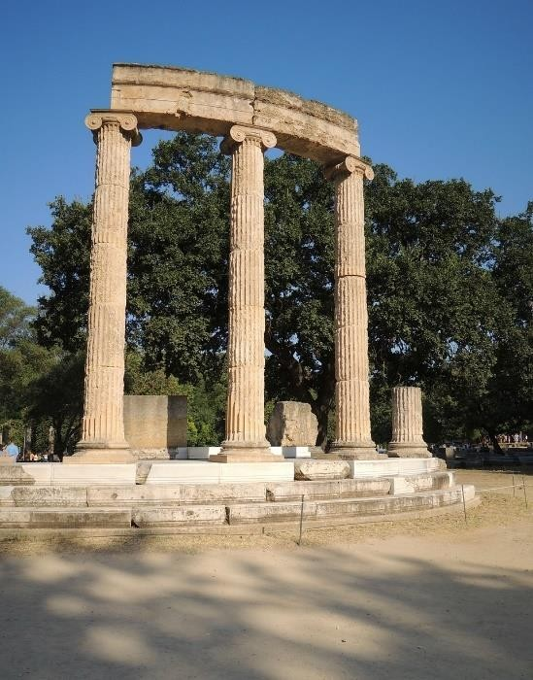
Tourism
Because of its warm weather and beautiful scenery, Greece is a popular destination for tourists. It is one of the most visited countries in the world, largely due to its Mediterranean climate and extensive coastline. With 18 UNESCO World Heritage Sites, Greece is rich in culture and history.
This Ancient Greek site was the birthplace of a sporting event still celebrated today.
30 million tourists visited Greece in 2019. That’s more than the Greek population!
This is Olympia, the site of the very first Olympic Games held in 776BC.

Slide 9
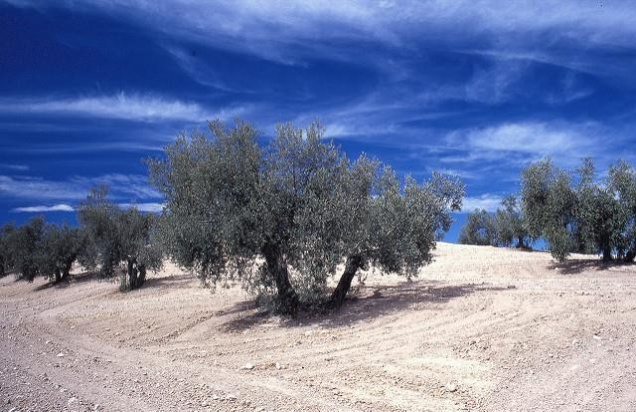
Greek Food
The most recognisable Greek food is the olive. Greek legend tells how the Greek Gods Athena and Poseidon both wanted to be guardian over the city of Athens. To decide the matter, whoever gave the city the best gift would become guardian. Athena’s gift of an olive tree was thought to be more valuable than Poseidon's gift of water.
An olive wreath was presented to the winner at the Ancient Olympic Games.
Olive trees can live for hundreds of years
Photo courtesy Mark Hodson Photos (@flickr.com) - granted under creative commons licence - attribution

Slide 10
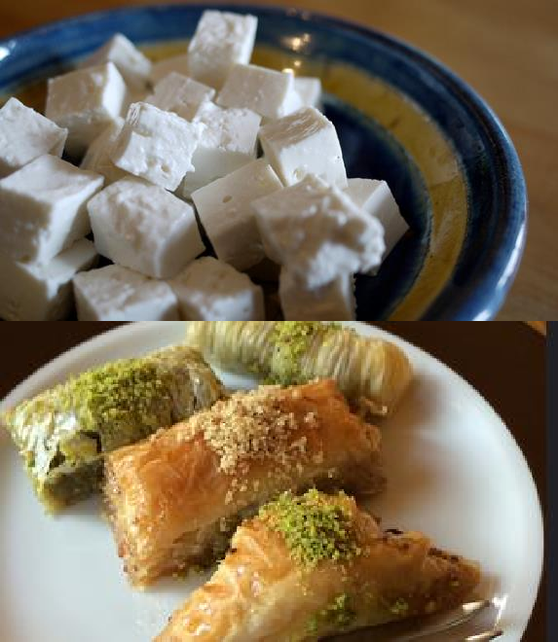
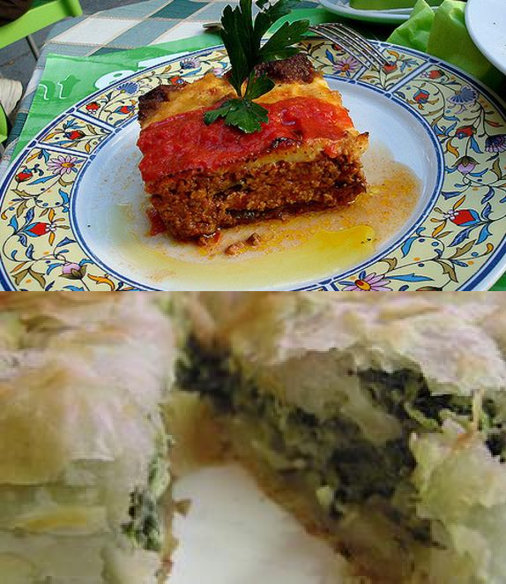
Greek Food
Small cafes, called Tavernas, serve delicious Greek food.
Feta cheese (Made with sheep and goat milk) | Moussaka (Minced lamb, aubergine and tomato)
Baklava (Filo pastry, nuts and honey) | Spinach and Cheese Pie (Filo pastry filled with spinach and cheese)

Slide 11
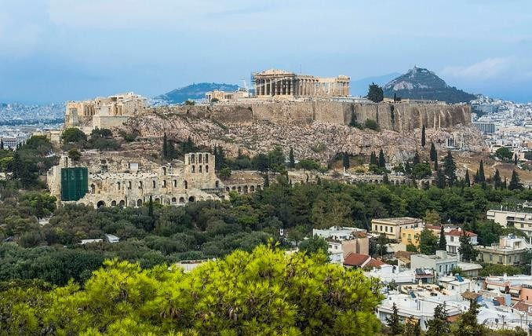
Athens
Athens is the birthplace of democracy, the system of electing a government, and is one of the oldest European cities. It has been continuously inhabited for more than 7000 years. Around 40% of the Greek population live here.

Slide 12
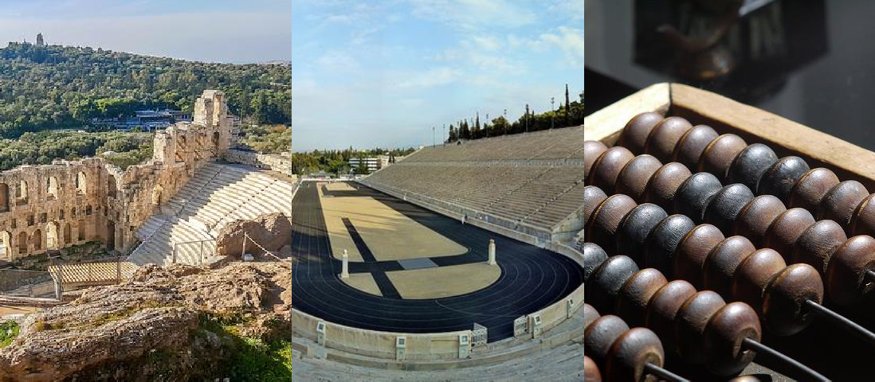
Ancient Greece
Ancient Greece inspired many things we still enjoy today.
Theatres | Olympic Games | Mathematics

Slide 13
Ancient Greek Wonders
The Colossus of Rhodes, one of the Seven Wonders of the Ancient World, was destroyed by an earthquake around 2000 years ago. | The Parthenon is a former temple, dedicated to the Goddess Athena who is said to be the patron of Athens. | The Acropolis is an ancient citadel, located on a rocky outcrop above the city of Athens.

Slide 14
Greek Traditions
Greek Dancing Traditional dances are about expressing emotions and telling stories. The ‘Kalamatiano’ is a celebratory dance performed by men and women, dancing in a circle. | Greek Homes Many Greek houses are painted white to reflect the sun. Blue and white also reflect the colours of the Greek flag- white and blue to symbolise the Greek sea and sky. | Greek Orthodox Church Religion is an important aspect of Greek culture. Around 98% of the population are Christian Orthodox.

Slide 15
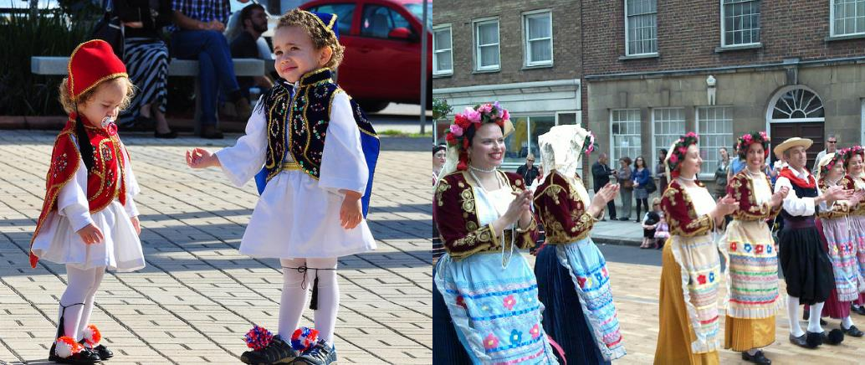
Ancient Greece
Traditional Greek dress is multi-layered and varies slightly between regions of Greece. For example, woollen stockings would be worn in the mountains to protect against thorny bushes. Men would wear a ‘foustanella’ or skirt, while women would wear colourful layers and a head scarf.

