Slide 1
Visual aids to make learning/teaching easier
Project 2020-1-CZ01-KA229-078166_5
THIS PROJECT HAS BEEN FUNDED WITH SUPPORT FROM THE EUROPEAN COMMISSION.
THIS PUBLICATION [COMMUNICATION] REFLECTS THE VIEWS ONLY OF THE AUTHOR, AND THE COMMISSION CANNOT BE HELD RESPONSIBLE FOR ANY USE WHICH MAY BE MADE OF THE INFORMATION CONTAINED THEREIN.

Slide 2
Fermentation and the chemistry of yogurt

Slide 3
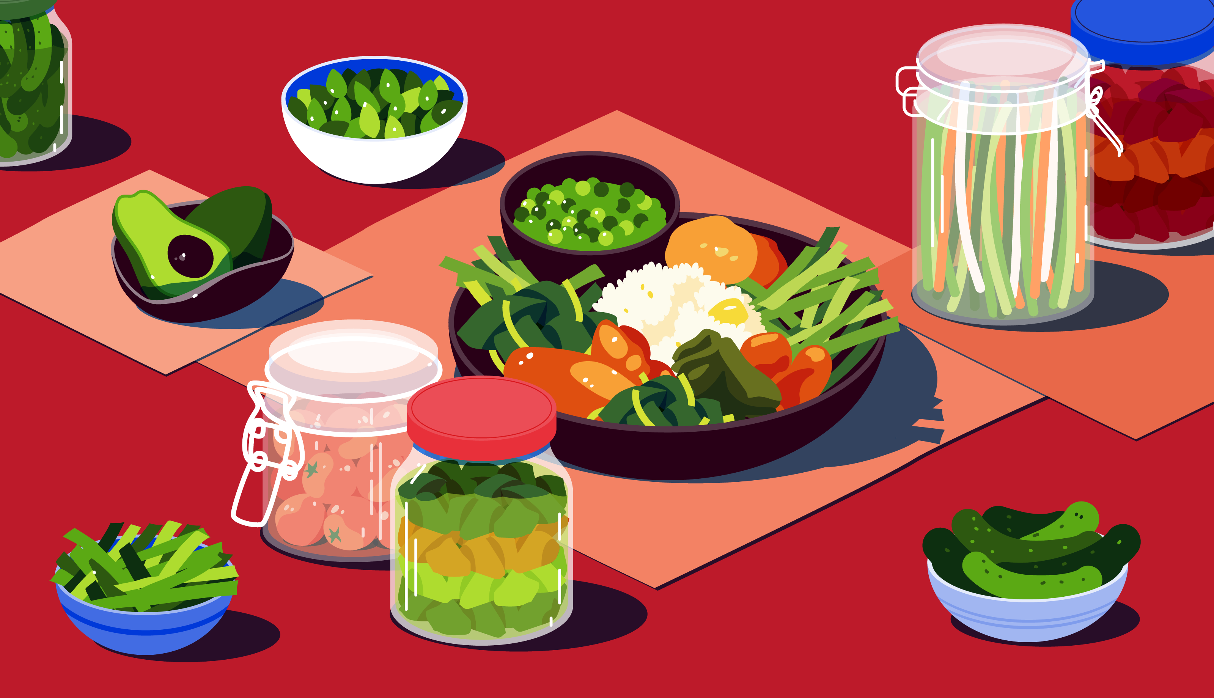
Why I chose this topic
For humans food and drink are more than just a necessity for survival. They’re a huge part of our culture and history, shaping our lives on a daily basis. And speaking of culture what is Bulgaria famous for if not with its yogurt, boza and rakia. All of those things wouldn’t exist without the process fermentation.

Slide 4
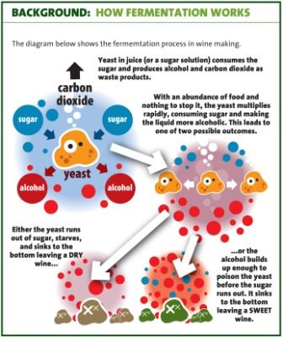
Fermentation
So what is fermentation? Well in biochemistry it is defined as the extraction of energy from sugars in the absence of oxygen, but in the context of food production it is referred to as a process in which the activity of microorganisms brings about a desirable change to a meal or beverage.

Slide 5
History of fermentation
Sounds complicated, but in fact from examining our DNA, scientists have estimated that our ancestors have developed the ability to metabolize fermented fruit juice without getting sick around 10 million years ago. Back then, the humankind hadn’t even split off from the ancestors of chimpanzees!

Slide 6
The importance of fermentation
But why is fermentation so important for us humans? Fermentation increases the content of valuable substances in food which makes it easier to digest and assimilate. When eating food containing live crops, we support the balance in the gastrointestinal tract and good digestion. Fermented foods also help synthesize certain vitamins and break down carbohydrates and proteins into easier-to-digest substances.

Slide 7
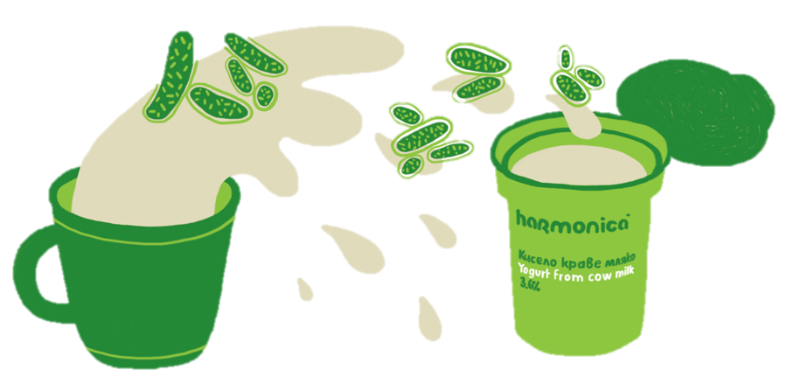
Making of yogurt
Now that we know the basics let’s talk yogurt! First of all I'm going to explain how the milk turns into our delicious yogurt. The traditional for our region bacteria Lactobacillus Bulgaricus and Streptococcus thermophilus feed on carbohydrates (lactose), multiply and as a result, release lactic acid, thus changing the taste and density of milk to the well known yogurt’s one.

Slide 8
You can make one yourself!
Of course, talking so much about yogurt, some of you might already feel hunger, but do not rush to the package bought from the store sitting in the refrigerator, as I will teach you how to make a homemade one. The products you will need are easy to remember - 1 litre of milk and 2 tablespoons of yogurt with living cultures (or use lyophilized bacteria instead).

Slide 9
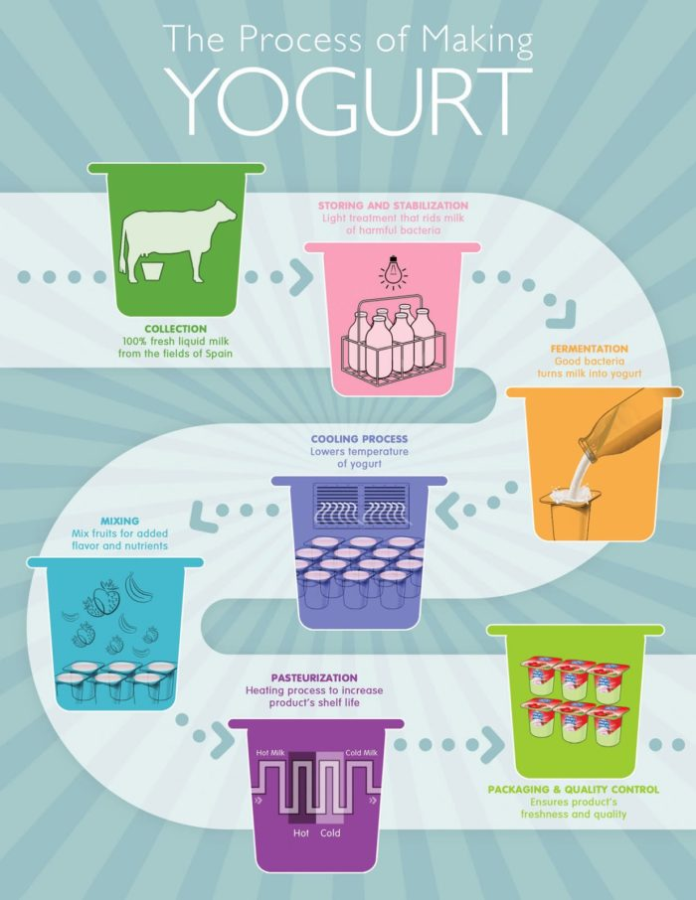
Homemade yogurt recipe
First we want to sterilize the milk in order to kill any unwanted bacteria and microorganisms. For this purpose we need to heat it until boiling for 15 to 30 minutes.
The next step is to cool down the mixture to 40 - 45 degrees Celsius, so as not to kill the bacteria that is contained in the yeast, which we will add later.

Slide 10
You might be wondering why we are adding bacteria when the previous step was to illuminate all the microorganisms. We are adding lactic acid bacteria, so that the fermentation begins and the milk turns to yogurt.

Slide 11
Thank you for your attention!

